Slide 1
ARRAY METHODS
For each() , push()

Slide 2
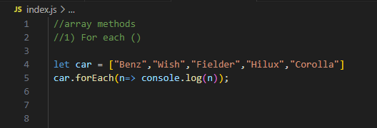
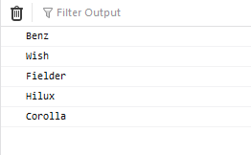
For Each()
It calls a function for each array element.
It takes a call back function ( callbackfn ) as an argument.
Syntax :
For Each( callbackfn )

Slide 3
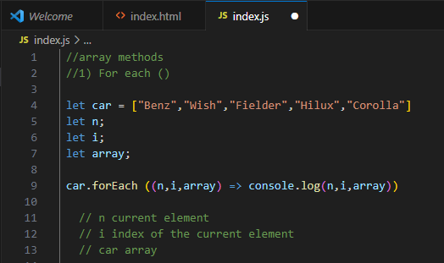
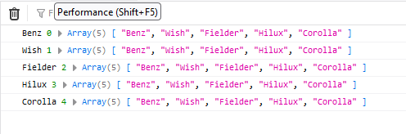
For Each ()
Call back function (callbackfn)
A function passed as an argument to another function

Slide 4
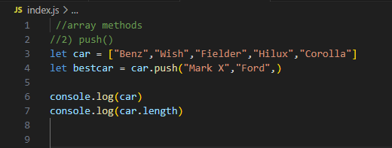

Push()
Adds a specified element to the end of an array and returns the new length of an array
Syntax :
Push (elements)

Slide 5
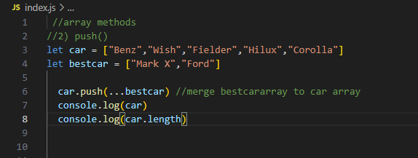
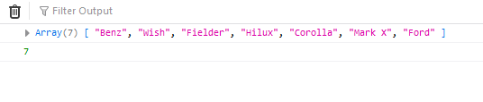
Push ()
Push () is used to merge two arrays

